Slide 1

Language Points

Slide 2
Para. 1-2
vi.晕厥
STONECHESTER—A teenage girl fainted yesterday at Stonechester High School after skipping meals.
Jennifer Jones, 15, told friends in her class that she was feeling unwell. She then passed out in her morning PE lesson and was rushed to hospital.
v.跳过
感到不适
失去知觉
被紧急送往

Slide 3
Para. 3
adv.危险地
Jennifer was found to have dangerously low blood sugar levels and was treated immediately. Her worried parents told the doctor that their daughter missed breakfast that day and hardly touched her dinner the night before. Fortunately, she is now out of danger. Her doctor says that she will make a full recovery in a day or two.
v.治疗
adv.立刻，马上
adv.幸运地
脱离危险
完全恢复

Slide 4
Para. 4
Jennifer’s classmates hope to see her back at school soon. They say that she has struggled with eating problems for a long time. “Jennifer thought that skipping meals would be a simple way to reach her target weight,” her friend Laura Williams told our reporter. “She has not eaten breakfast for the last few months. She told me she had trouble concentrating in class. I warned her that skipping meals was unhealthy, but she wouldn’t listen.”
与...斗争
达到目标体重
难以集中注意

Slide 5
Para. 5
Jennifer’s case is a reminder of the dangers of the unhealthy weight-loss habits that have become common among teenagers of both sexes. In a society where being thin is often seen as being beautiful, teenagers sometimes turn to extreme methods to slim down quickly.
n.案例
n.提醒
通常被视为
adj.极端的
瘦身

Slide 6
Para. 5
根据
According to a recent survey of senior high school students’ lifestyles, almost one fifth of teenagers regularly skip meals, one in ten over-exercise and four per cent even take weight-loss medicine. Health experts are concerned about these figures. They are increasing their efforts to educate teenagers about the side effects of losing weight too quickly. They have also warned them against using such extreme methods.
五分之一
adv.经常地
关注
副作用
警告不要做...

Slide 7
Para. 6
急速减肥法
v.证明是
“These so-called ‘quick-fix methods ’ prove to be harmful to teenagers. It is normal for teenagers to be slightly overweight and there is no reason why they should be worried. However, for those who are dangerously overweight, it is very important that they try to lose weight properly,” said an expert.
对...有害
adv.轻微
adv.危险地
adv.适当地

Slide 8
Para. 7
adj.均衡的
n.饮食
She pointed out that it is important to have a healthy balanced diet since teenagers are still growing and their bodies need a lot of nutrition to function well. If they do not take in enough food, they may feel weak and get ill easily. She added, “What’s more, they should keep regular hours and get plenty of exercise to stay energetic and fit. We strongly encourage all teenagers to follow these lifestyle tips, because living well is the safest and most effective way to get into shape.”
n.营养
v.运转
此外
规律作息
大量的
adj.精力充沛的
adj.健康的
adj.有效的
强身健体

Slide 9
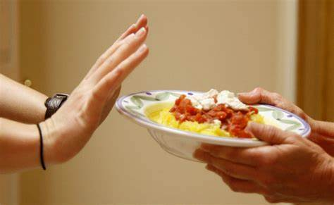

1. skip
skip 的词源义和基本义是“跳（过）” (spring lightly, jump over)
...after skipping meals(L3)
①vt. 不做（应做的事情等）
skip class/breakfast 不去上课/不吃早餐
skip a grade 跳级
②vi. &vt. 跳过，略过
skip (over) sth. 略过... skip to sth. 跳到
skip (over) the next chapter 跳过下一章
skip to the next chapter 跳到下一章
③vi. 蹦蹦跳跳地走
On hearing the news, the girl skipped away happily.
听到这个消息，女孩高兴地蹦蹦跳跳地走了。

Slide 10
2. pass out
昏迷，失去知觉
She then passed out in her morning PE lesson... (para. 2)
She then ________ in her morning PE lesson.
She was found ___________ in her morning PE lesson.
fainted
unconscious
他感觉恶心，眩晕（dizzy），接着就昏倒了。
He felt sick and dizzy and then passed out.
pass away
pass over
pass by
pass down
传承，流传
去世，消失
错过，走过
忽略，避而不谈

Slide 11
Several people were passing but nobody offered to help.
2. Can you pass me that bag by your feet?
3. She became more ambitious as the years passed.
4. Plans to extend the hotel have now been passed.
5. Are you allowed to pass the ball back to the goalkeeper?
通过，走过
给，递，传递
推移，逝去
经表决通过
传球

Slide 12
3. immediately
...and was treated immediately（L9）
①adv. 立即，马上
同义短语：at once/right away
②conj.(连词) 一...就
Immediately she took off her sunglasses, I recognized her.
她一摘下墨镜，我就认出了她。
The moment the crisis broke, the government took action to cope with it.
危机一爆发，政府就采取了应对措施。
Upon his arrival, all his friends came out to welcome him.
他一到，他所有的朋友都出来欢迎他。
同义短语:the moment/minute/second/instant、as soon as、on/upon (doing) sth.

Slide 13
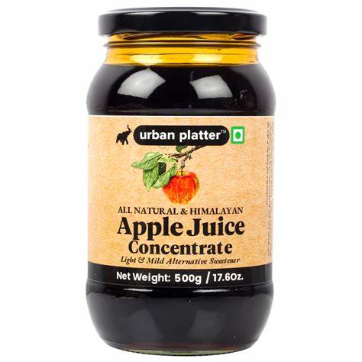
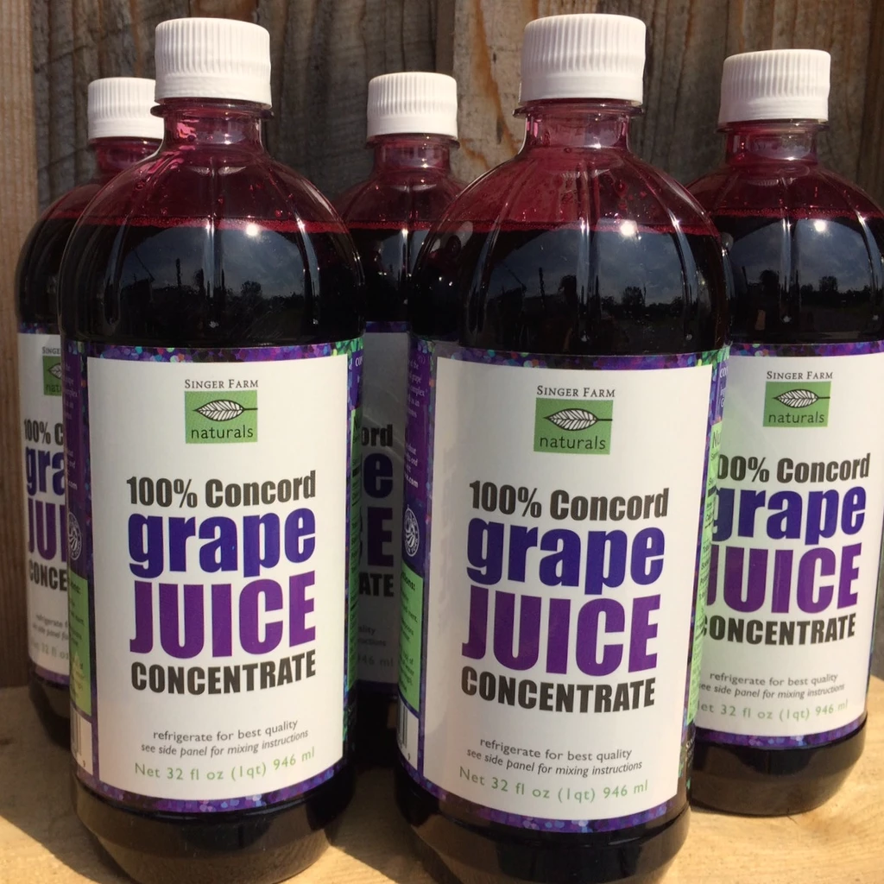
4. concentrate
进口果汁的商标上面往往有“apple juice concentrate; grape juice concentrate”等，那么大家知道concentrate在这里是什么意思吗？

Slide 14

concentrate
she had trouble concentrating in class.(L17)
■ vt & vi
❶ (使) 聚集于；(使) 浓缩：
Italian industry is concentrated mainly in the north.
意大利的工业主要集中在北部。
❷ 专心；集中 (注意力、思想等)：
We must concentrate our efforts on improving education.
我们必须集中力量改善教育。
■ n [C] & [U] 浓缩物；浓缩液：
orange juice concentrate 浓缩橙汁
同义异构：focus
concentrate (sth) on (doing) sth
► concentrated adj 浓缩的；聚集的；全神贯注的
be concentrated on (doing) sth
► concentration n [C] & [U] 集中；专心：

Slide 15
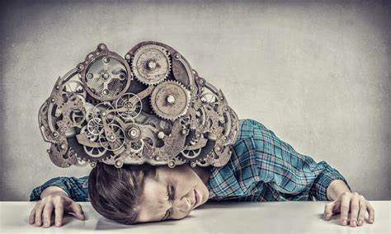
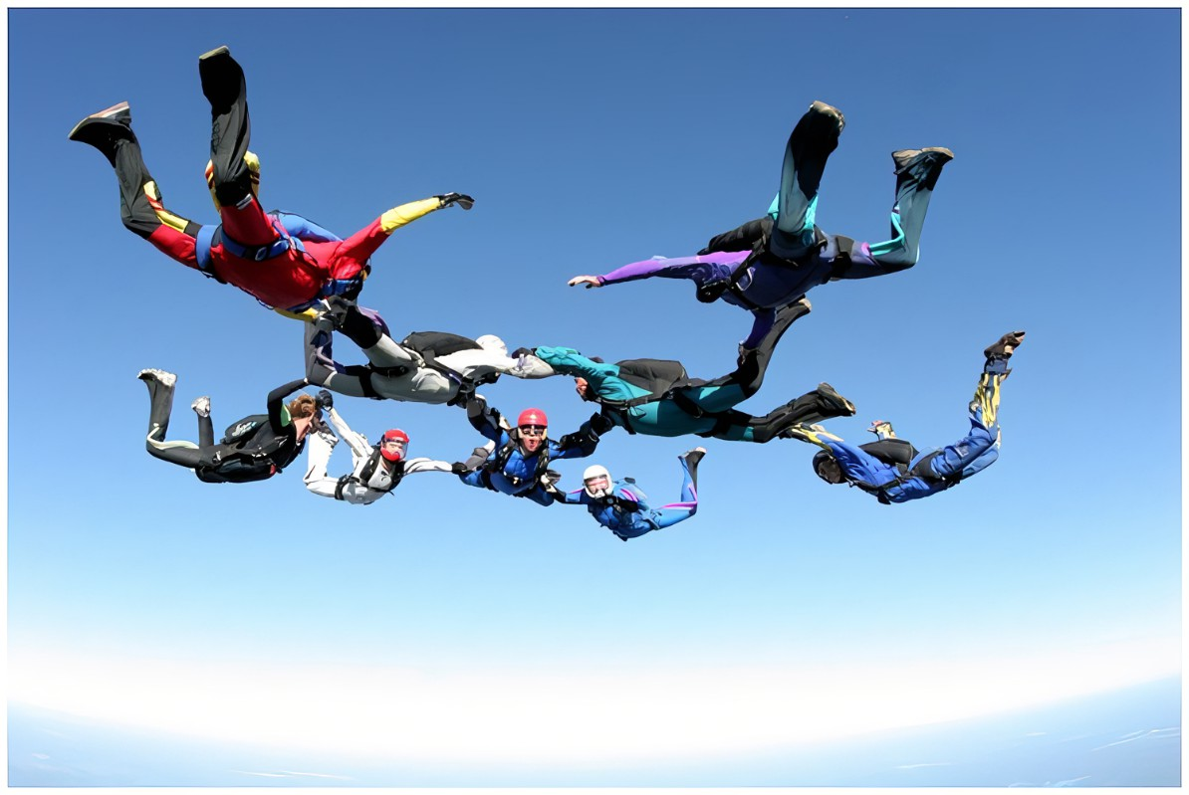
5. extreme
teenagers sometimes turn to extreme methods(L22)
■ adj.
① 极端的，严重的
an extreme case/example 极端的例子/案例
The method is proper only in extreme circumstance.
这种方法只有在极端情况下才是合适的。
② 极度的，极大的；偏激的
under extreme pressure 在极大的压力下
■ n. 极端不同的感情（或境况、行为方式等）
take sth. to/go to extremes 走极端
in the extreme 极度，非常
The sport would be dangerous in the extreme.
这项运动极其危险。
=extremely dangerous

Slide 16
6. slim down
...to slim down quickly.（L22）
slim down 变苗条，减肥；减少（岗位），裁减（人员），精简（机构）
These factories are slimming down their workforce.
这些工厂正在裁减工人。
slim adj.
①苗条的
My sister has a slim figure because she takes regular exercise.
我妹妹有一个苗条的身材，因为她经常锻炼。
②微薄的，小的
There is only a slim chance that he come in time.
他及时来的可能性很小。
slimmer（比较级）

Slide 17
7. concerned
❶ [不用于名词前]有关的；有关联的：
be concerned with / in:
Her job is something concerned with computers.
她的工作与计算机有关。
❖ 担忧的；关心的 worried about sth, or caring about sb：
be concerned about / for:
As tourism develops, people are becoming increasingly concerned about the environment.
随着旅游业的发展，人们越来越关心环境问题。
as far as … be concerned 就……而言；关于

Slide 18
8. effect
作用，效果，影响
greenhouse effect 温室效应
Global warming is having a great effect on hundreds of plant and animal species around the world.
bring / put ... into effect 实施；实行
in effect
❶ 在实施中；有效：
Some laws from the eighteenth century are still in effect.
❷ 实际上；事实上：
“Have a nice day” is a wonderful phrase, reminding us, in effect, to enjoy the moment.
对...有影响

Slide 19
side effect 副作用
Health experts are increasing their efforts to educate teenagers about the side effects of losing weight too quickly.（L27）
take effect 生效 (come into effect)；起作用：
These measures are just beginning to take effect.
词汇拓展
► effective adj 有效的 反 ineffective ；生效的：
take effective measures / steps 采取有效措施/步骤
► effectively adv 有效地
► effectiveness n [U] 有效性

Slide 20
9. prove
These so-called ‘quick-fix methods ’ prove to be harmful to teenagers.(L)
These so-called “quick-fix methods” ____ ____ to be harmful to teenagers.
turn out
①［用作系动词］证明是；被发现是 (turn out)
The new drug proved effective.
这种新药证明是有效的。
The plan has proved a great success.
这个计划已被证明是非常成功的。
The promotion proved to be a turning point in his career.
这次晋升被证明是他事业的转折点。

Slide 21
② vt 证明；证实：
Just give me a chance and I’ll prove it to you.
证明给你看
prove sth to sb
They hope this new evidence will prove her innocence.
证明她的清白
She was determined to prove everyone wrong.
prove sb / sth (to be) + adj / n
证明所有人错了
Tests have proved that the system works.
证明了
prove + (that) / wh-从句
It has been proved that eating vegetables is beneficial to you.
已经证明
It is proved that...

Slide 22
10. function
...their bodies need a lot of nutrition to function well (L36)
①to work in the correct way 起作用，正常工作，运转
Despite the power cuts, the hospital continued to
function normally.
effectively 有效地
correctly 正确地
properly 合适地
smoothly 顺利地
successfully 成功地
perfectly 完美地
function
functional
adj.实用的

Slide 23
②A library is functioning as a temporary hospital to cope with casualties（受害者）.
to perform the action or the job of the thing or person mentioned 起…作用，具有…功能
同义短语：function as/work as/act as/serve as
③The function of the heart is to pump blood through the body.
a special activity or purpose of a person or thing 作用, 功能
fulfill
perform
carry out
main/chief/
vital/primary/
essential
functions

Slide 24
11. take in
If they do not take in enough food...(L36)
to absorb sth. into the body 吸收
Don’t be taken in by products claiming to help you lose weight in a week.
2. He was homeless, so we took him in.
3. Halfway through the chapter I realized I hadn’t taken anything in.
4. They continued a few miles further to take in a movie.
欺骗
收留
理解
观赏

Slide 25
12. frightened
I was very frightened when I woke up in hospital last Thursday. (P47)
be frightened of (doing) sth:
I’m frightened of walking home alone at midnight.
我害怕半夜一个人走回家。
frightening adj 令人害怕的；吓人的 making you feel afraid ：
a frightening experience / thought
可怕的经历/想法

Slide 26

13. rather
◆ 相当；颇 (quite)：
She fell and hurt her leg rather badly.
❖ 相反地；反而：
It’s not cold. Rather, it’s very hot.
or rather 更确切地说：
He worked till late last night, or rather, early this morning.

Slide 27
rather than 而不是：
From now on, I’ll pay more attention to my health rather than my weight.
It is better to express your anger, rather than bottle it up.
would rather ... (than) 宁愿 / 宁可……（而不）：
— Will you join us in the game?
— Thank you, but I’d rather not.
She would rather die than give in.
It’s getting late. I’d rather (that) you left now.

Slide 28

2410: 19mins 2412: 21mins
Fight for the Video

Slide 29
4‘
benefit
翻译下面的句子（每空一词）。
阳光对植物有益。
Sunshine is good for plants.
1. Sunshine __________ plants.
2. Plants __________ __________ sunshine.
3. Sunshine __________ __________ __________ plants.
4. Sunshine __________ __________ __________ __________ plants.
benefits
benefit
from
is
beneficial
to
is
of
benefit
to

Slide 30
7‘
seek
On a hot summer day in last August, I ________ (seek)
shade and a cool drink at a waterfront café.
2. Some businesses only seek ________ (earn) enough to
cover their operating costs. （2013 全国）
3. Unluckily, they sought in vain ________ somewhere to
shelter.
4. A job ________ (seek) is an unemployed person who is
trying to get a job.
sought
to earn
for
seeker

Slide 31
is seeking to improve
5. The company ____________________ （正试图提高）the
quality of products.
6. The government ______________________ （正在寻求解决
办法）to the problem of water shortage.
7. From this experience I have learnt that questioning can serve
as a bridge that helps us to ________________ （寻求真理）.
is seeking for a solution
seek the truth

Slide 32
5‘
escape
1. Time is something ________ which we can’t escape.
2. Compared with the ________ (escape) driver, I am proud of what I did. (2014 湖北)
3. He was lucky to escape ________ (be) liked.
4. Although he thought he could ______________（逃过注意）by sitting at the back, he was wrong.
5. It was reported that two journalists ________________________
（死里逃生）in the air attack.
from
escaped
being
escape attention
narrowly escaped death / had a narrow escape

Slide 33
6‘
recognize
recognized
1. Shanghai may be the _____________ (recognize) home of the soup dumplings. (2023 新课标)
2. The actor is used to ______________________ (recognize) in the street.
3. Having problems with facial ______________ (recognize) is in a way known as face blindness.
being recognized
recognition

Slide 34
4. I can go to the airport and meet Professor Smith for you. ______________________ (我怎样才能认出他来)?
5. Bach died in 1750, but it was not until the early 19th century that his musical gift ______________________ (得到充分的肯定). (2015 重庆)
6. I haven’t seen Sara since she was a little girl, and she ______________________________ (已经变得认不出来了).
How can I recognize him
was fully recognized
has changed beyond recognition

Slide 35
3‘
concentrate
concentration
1. Listening well also requires total ______________ (concentrate).
2. He made a _______________ (concentrate) effort to improve work.
3. When meeting a group of people, concentrate _______________ remembering just two or three names.
concentrated
on

Slide 36
7‘
concerned
with
1. Officials should concern themselves ______ public affairs.
2. The meeting was concerned _______ reforms and everyone present was concerned _______ their own interests.
3. The news shocked the public, leading to great concern ________________ students’ safety at school.
with
for
about / for / over

Slide 37
用concern的正确形式填空。
4. The letter has been given to people _________.
5. One of the _________ that people have is the side effects of treatment.
6. As far as Americans ______________, a lot of our hotels are below average.
7. As a grassroots singer, she reads everything she can get hold of ____________ music, and takes every opportunity to improve herself. (2014 福建 )
concerned
concerns
are concerned
concerning

Slide 38
4‘
effect
1. Global warming is _____________________ (对……产生巨大的影响) hundreds of plant and animal species around the world.
2. The convenience even leads fewer people to take public transport—an unwelcome __________________ (副作用) researchers have already found in ride-hailing (叫车) services. (2018 北京)
3. According to the recent research, heavy coffee drinking and heart attack is not necessarily __________________ (因果关系).
4. Few laws are so effective that you can see results just days after they ____________________________ (生效).
having a great effect on
side effect
cause and effect
take effect / come into effect

Slide 39
3‘
prove
1. 给我一个机会，我会证明给你看。
Just give me a chance and ____________________.
2. 事实证明了这本书非常成功。
__________________________________________________
3. 经证实，童年时吃蔬菜有助于日后不生大病。
_________________________ eating vegetables in childhood
helps to protect you against serious illnesses in later life.
I’ll prove it to you
The book has proved (to be) very successful / a great success.
It has been proved that

Slide 40
4‘
rather
一、写出下列句子中画线部分的汉语释义。
1. It was rather difficult to get a job in the USA. ________
2. If what your friend comes up with surprises you, don’t reject it immediately. Rather, imagine that it is true. ________
二、根据所给汉语完成下列句子。
3. My wife and I still find it convenient to have a home phone _______________ (而不是) providing a mobile phone for every family member. （2021 全国改）
4. We _______________ (宁愿) our daughter stayed at home with us, but it is her choice, and she is not a child any longer. (2014 江西)
相当
相反
rather than
would rather

Slide 41
4‘
pass away, pass over, pass by, pass down
passing by
Will you be ____________ the supermarket on your way home?
The tradition has been ____________ from father to son for generations.
This is the second time I’ve been ___________ for promotion.
Sadly, he ____________ last year.
passed down
passed over
passed away

Slide 42
6‘
用括号内单词的正确形式填空，体会分词形容词。
1. This story is _________ (interest) and fun for the whole family to enjoy. (2014 全国)
2. I’m really ________ (interest) in this position and hope I can work for you. (2014 辽宁)
3. They say it’s _______ (bore) to hear the same songs all the time.
4. _______ (bore) with life in the city, he moved to a village.
5. Starting university can be exciting, and can also be _______ (worry).
6. She was very _______ (worry) about her sick mother.
interesting
interested
boring
Bored
worrying
worried

